Slide 1
Quick Introduction to inspectIT
Focus on the CMR
Date: 20.01.2017

Slide 2
The inspectIT ecosystem
Analysis UI (Rich Client)
Monitoring UI (web-based)
CMR
Long-Term Data Storage
REST Interface
Analysis Data Storage (Traces)
…
InfluxDB (Platform Data, Request Statistics)
…
H2 (Platform Data)
Analysis Agent Interface
Browser Agent
Java Agent
inspectIT Integration
Mobile Agent
collectd
.NET Agent
Data Sources (running on the system under test)

Slide 3
Main Components
Agent
CMR
UI
Collect data
Storing the data
Providing Config for agents
Analysing the data
Specify the configuration

Slide 4
Code Packages
.shared.all
.agent
.server
.ui.rcp
.shared.cs
Java Version
6
7

Slide 5
Important Third-Party Dependencies
Frameworks
Spring (Initialization of Components)
KryoNet (Used for Agent-CMR & CMR-UI communication)
Databases
H2 (Platform Data (CPU, Memory, …), Charting Data)
optional: InfluxDB (used for Platform Data instead of H2)

Slide 6
Registration
Agents and Methods are registered
Unique ID for each agent and method
Agent sends ID instead of method name (reduces amount of data sent)
BUT
Mapping is NOT persistent
After CMR restart, the agent is not able to send data anymore (will be changed in future)

Slide 7
Storing Data Flow
CMR
DataProcessor
Agent
Data Buffer
AgentStorageService
EntityManager
DataProcessor
…
Traces are stored in-memory only! Not persistent!

Slide 8
Package Structure
Main
Alerting (Specifying thresholds, …)
Classes related to the data buffer
Services for Configuration Interface (load profiles…)
All data access objects
Common events
External Services (Influx, Mail Server)
Classes related to the InfluxDB service

Slide 9
Package Structure
Classes related to the InfluxDB service
Classes related to the instrumentation process
Class cache (which classes are available on the agent)
Handles instrumentation changes (dynamic instrumentation)
Provides the instrumentation config for the agents
Mail Service
Push functionallity to provide messages for the agent
Data Processors
Handles the CMR configuration (default.xml)

Slide 10
Package Structure
Services (REST service,InfluxDB service, Data Access)
Wraps different DAOs and provides additional functionallity
Starts external services
Classes related to the data storage (storage != buffer)
Spring configuration (data processors, beans, …)

Slide 11
Package Structure
After changing the configuration (adding/ removing entries) the schema should regenerated
.\gradlew.bat schemagenConfiguration
CMR configuration

Slide 12
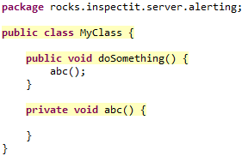
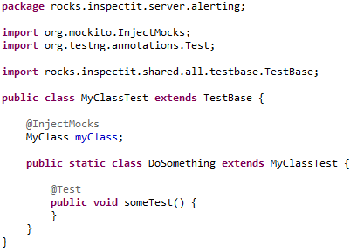
Testing
Try to cover all flow paths (100% code coverage might still miss some test cases)
Tests should be in the following structure:
same package
Classname + „Test“
Common attributes
Nested Class for each method
Only public methods required

Slide 13
[main] INFO rocks.inspectit.server.CMR - CMR started in 13867 ms

Slide 14
Get in Touch With Us
www.inspectIT.rocks
@inspectIT_APM
inspectIT
inspectIT-docker
inspectit
Notes:
Star us on GitHub

